Slide 1

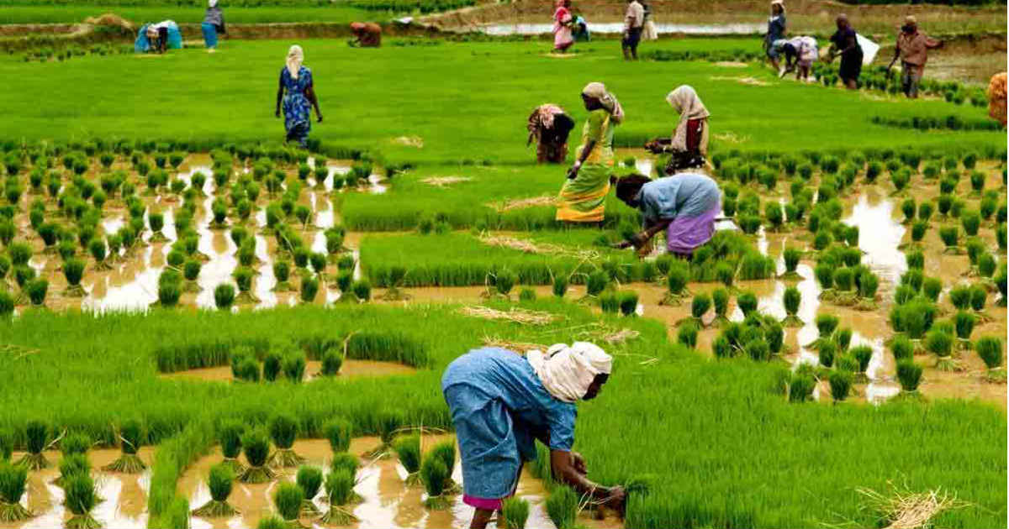
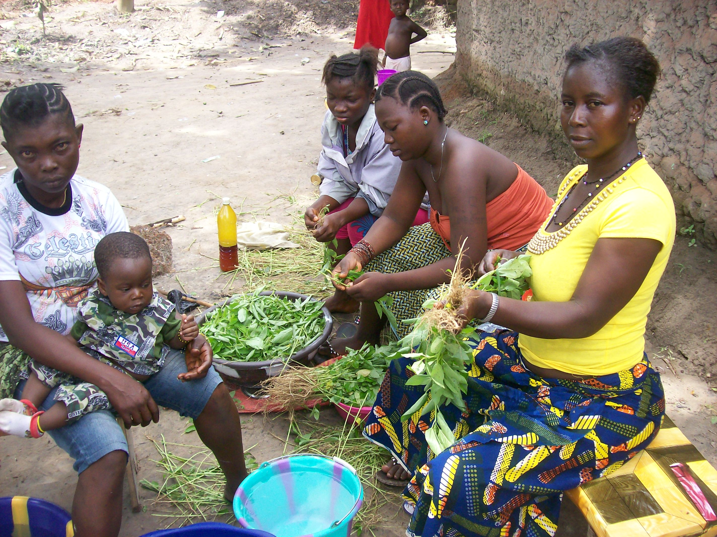
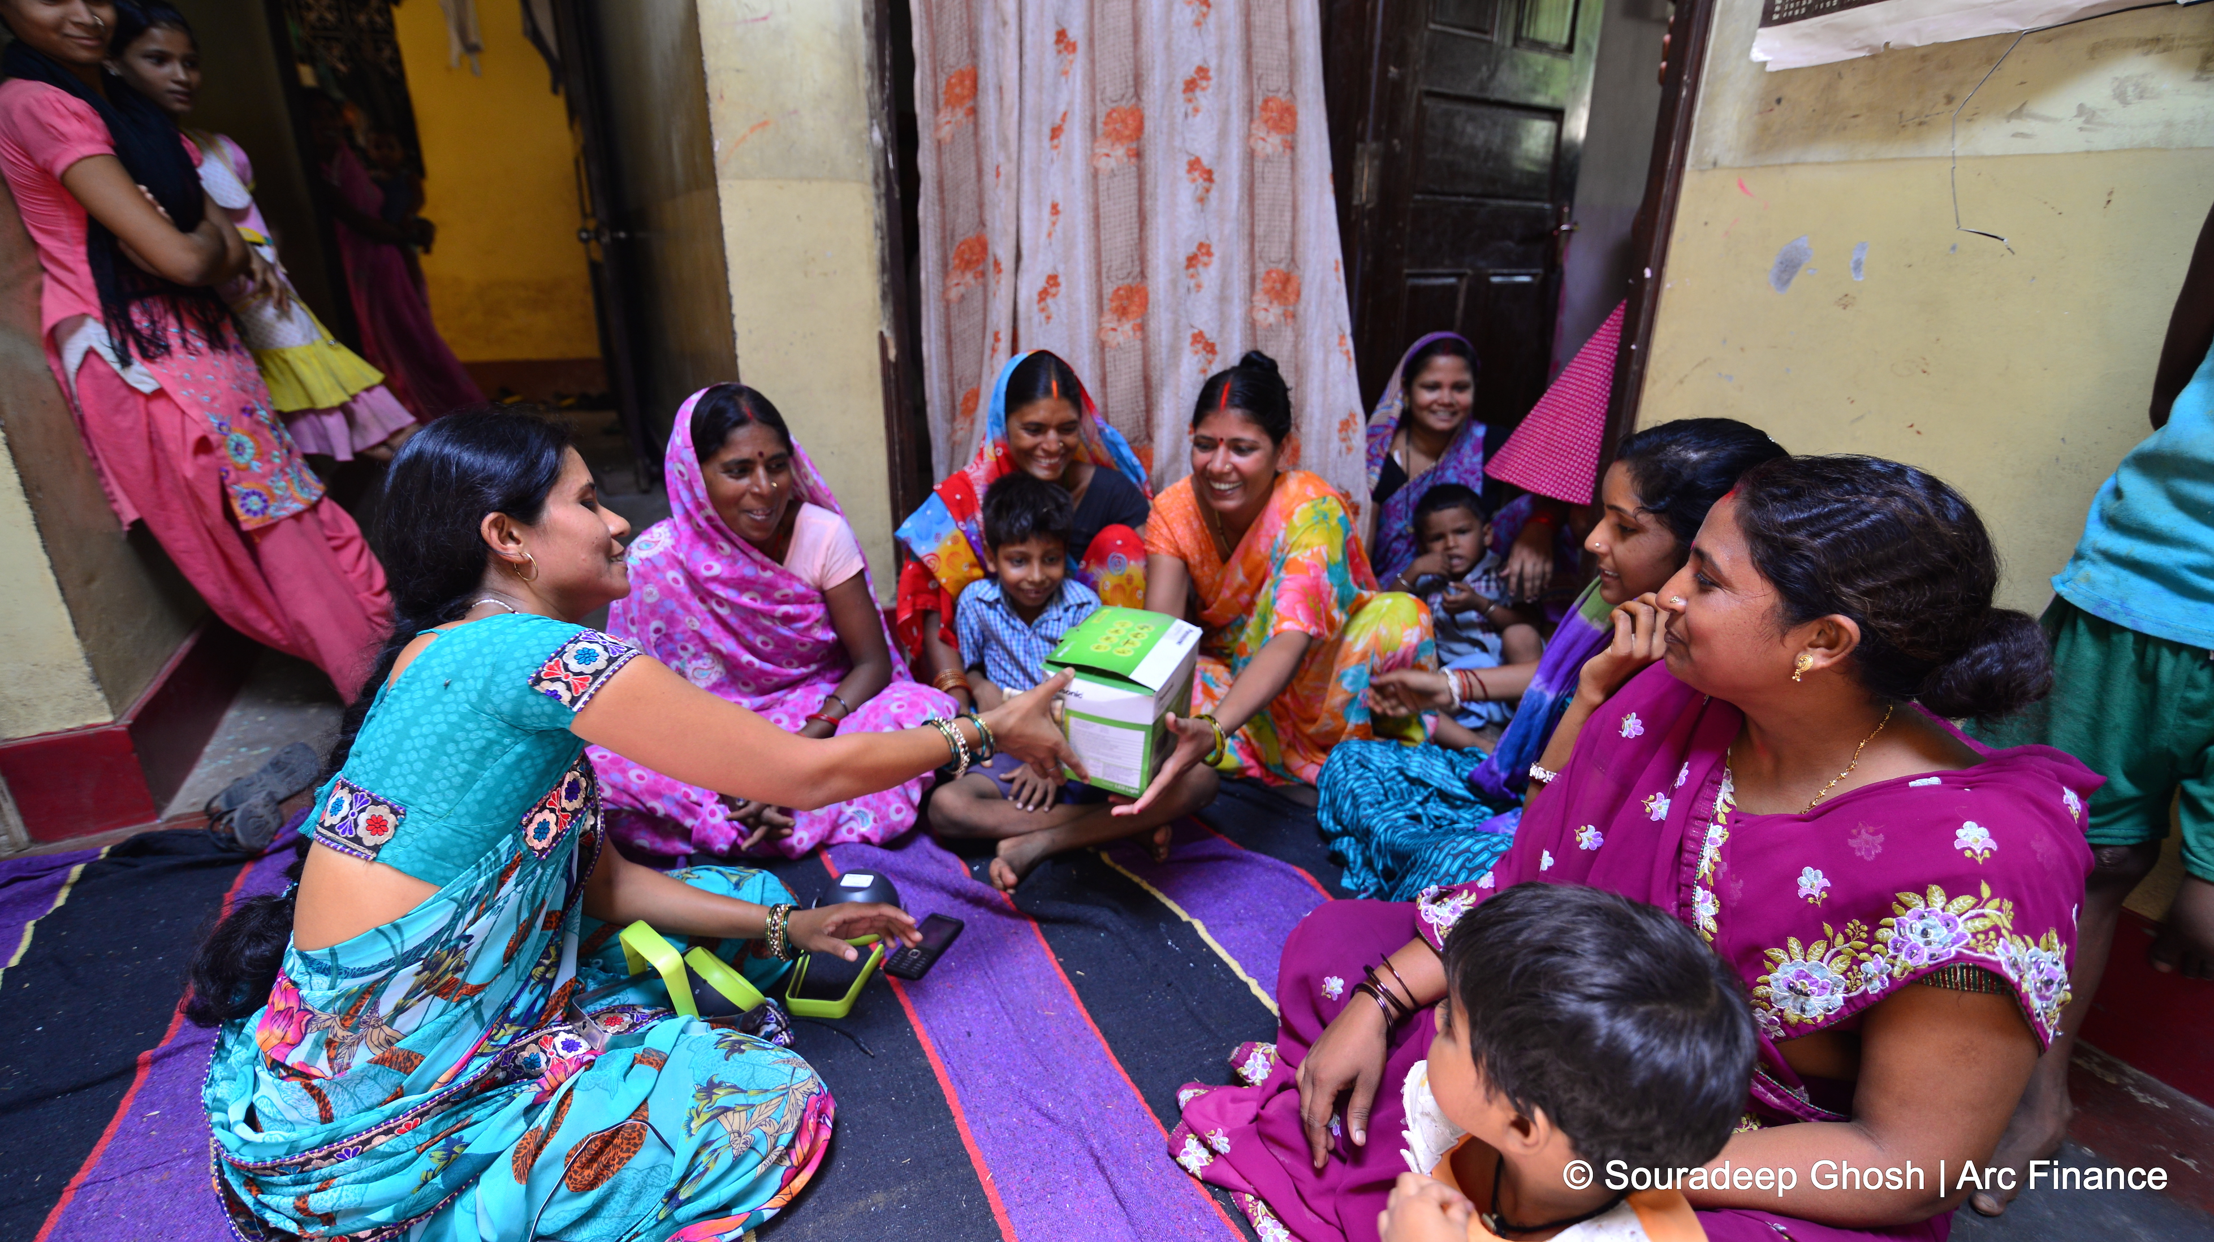
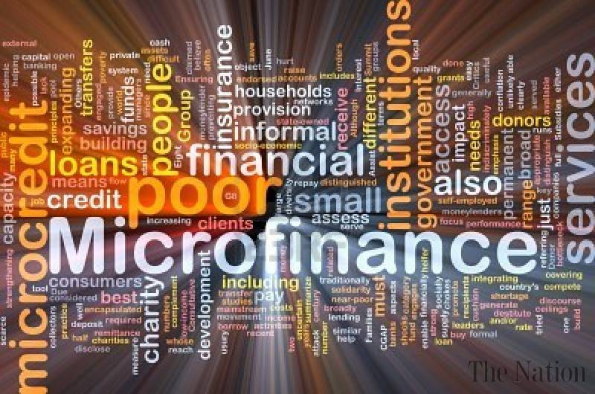
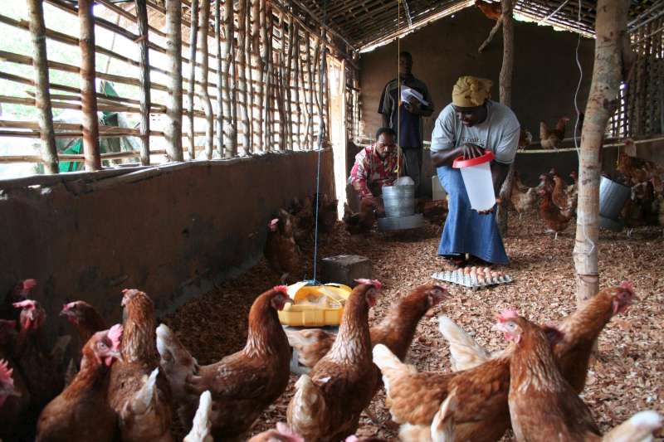
Micro-enterprise Credit Program: Deja Vu
Dale W Adams & J.D. Von Pischke (1991)
Presented by: Ahmad Waleed Majidyar

Slide 2

OVERVIEW
Governments and Donors have increased the number of programs in low income countries directed at owners of small businesses (microenterprises) due to increased interest in private businesses.
Assumptions
ME Credit Program
Small Farms Credit Programs
Policies
Tussle with Definitional Issues
Same Type of Project justification

Slide 3
Date back to early 1900s
After WWII there was a surge in these efforts accompanying the growth of modern foreign assistance where donors and governments spawned hundreds of small farmer credit projects involving tens of billions of dollars
Most LICs had at least one program while others multiple programs.
Credit for Small Farms
Most institutions extending loans to farmers under these programs lost money, and many others withered away, disappeared, or were sustained by recapitalization
While, institutional arrangements were diverse, many programs were patterned after organizations found in donor countries.
US intervention in Latin America, Philippines, Ghana, Vietnam- rural private banks
Several EU countries exported cooperatives to provide loans to rural people
In Asia, governments and donors formed institutions to provide rural financial services
Countries introduced regulations- forcing banks to lead a larger portion of their loan portfolio to small farmers, either directly or indirectly through development banks.
Donors such as the WB promoted specialized rural development banks.

Slide 4
Common Assumptions
Target group was viewed as being too poor to adopt new technologies without formal loans and too poor to save.
Operators of small farms need training and technical assistance to progress
Promoters argued that informal finance either played little or no positive development role, or that it was an evil that should be eliminated
Most of the target groups had credit needs that commercial bankers refused to fill for reasons that were neither commercial nor economic
Finally, most of these credit programs were justified on the basis of expected increases in production, project evaluations concentrated on measuring the impact of loans on changes in borrowers’ output, income, or employment. The impact of credit programs on the financial infrastructure was largely ignored.

Slide 5
Loan guarantees to induce banks to lend to target groups
Concessionary lines of credit to stimulate targeted lending
Policies and Practices
Subsidized interest rate on loans made to ultimate borrowers
Little attention to deposit mobilization
Emphasis on making relatively large-and long term loans
Almost exclusive reliance on government and donor funds
Loan size and repayment terms were usually determined from farm budgets where risk was not reflected in these budgets; normal year assumptions were used
Microenterprise financial models are less oriented to rates of return, but are still largely based on normal year assumptions
While borrowing may allow entrepreneurs to expand their activities, it leads them into more risk and debt, unless loans are grants disguised as credit
Because of the nature of funding sources, there was often pressure in small farmer credit programs to disburse funds quickly and to reward staff on the basis of loans made
Notes:
Common assumptions spawned virtually identical policies and practices in small farmer and microenterprise credit.
Loan guarantees induce banks to lend to target groups, concessionary lines of credit to stimulate targeted lending, subsidized interest rate on loans made to ultimate borrowers, little attention to deposit mobilization, emphasis on making relatively large-and long term loans, and almost exclusive reliance on government and donor funds.
Loans were not based on the amount of cash the farmer could reasonably be expected to repay after satisfying more pressing priorities and after the effects oi bad agricultural years or other things that could reasonably be expected to go wrong. Loan size and repayment terms were usually determined from farm budgets constructed primarily to derive the rate of return from the activity for which the loan was issued. Risk was not reflected in these budgets; normal year assumptions were used
Microenterprise financial models are less oriented to rates of return, but are still largely based on normal year assumptions.
While borrowing may allow entrepreneurs to expand their activities, it puts them into debt, unless loans are grants disguised as credit
While borrowing may allow farmers to expand their activities, it carries with it an additional cost through exposing them to more risk, including the risk of not being able to repay loans.
Because of the nature of funding sources, there was often pressure in small farmer credit programs to disburse funds quickly and to reward staff on the basis of loans made.

Slide 6
Target Groups Definition
Much time was spent in seminars and conferences on small farmer credit attempting to define precisely:
The Landless
Peasants
Tenants
Part-time Farmers
Small, Medium and Large Size Farmers
Little attention was given for searching for the characteristics of loan applicants who would use credit productivity and repay on schedule
Project Justifications
”The Four Standard Deviation Spread” was used to justify the projects
The spread began with citation of horror stories about interest rates charged by informal lenders (the levels cited often two standard deviations above the norm in formal financial markets)
The project promoted was typically portrayed as free of any material risks for the lenders who accepted the ultimate loan recovery responsibility. This assumption, in turn, was often two standard deviations beyond the norm later experienced in these projects
Many credit projects were dressed up as programs to promote fertilizer use, purchase of machinery, irrigation, cattle production, or a particular crop or technology. Little emphasis on financial system and basis of credit worthiness.
Poor financial housekeeping in agricultural finance institutions was common, and donor records were such that they had no overall view of the financial performance of the projects they supported.
Project performance was measured by the number of loans made, tons of fertilizer sold, number of tractors purchased, acres of land irrigated, number of cattle procured with loans, and acres of crops financed by loans
Notes:
The small farmer credit programs were comprised by incomplete loops in the procedures and culture of the institutions designing them:
General lack of interest in sustainability of debtor-creditor relationships
Much time was spent in seminars and conferences on small farmer credit attempting to define precisely the landless, peasants, tenants, part time farmers, small farmers, medium sized farms, and large farms rather than on searching for the characteristics of loan applicants who would use credit productivity and repay on schedule.
Recent discussions of what constitutes a microenterprise, or a small or medium sized firm are reminiscent of those sections.
The quest for precise definition of smallness is driven by the compulsion to target assistance. But if a microenterprise is defined as having ten or fewer employees, is a frim that has eleven employees much different and does the definition have any relevant for the financing of the enterprise.
Project Justifications
” The four Standard Deviation Spread” was used to justify numerous small farmer credit projects that survives today in promotion of many microenterprise Credit programs.
The spread began with citation of horror stories about interest rates charged by informal lenders (the levels cited often two standard deviations above the norm in formal financial markets.
The project promoted was typically portrayed as free of any material risks for the lenders who accepted the ultimate loan recovery responsibility. This assumption, in turn, was often two standard deviations beyond the norm later experienced in these projects.
Further, many credit projects were dressed up as programs to promote fertilizer use, purchase of machinery, irrigation, cattle production, or a particular crop or technology. In their heyday, farm credit projects were justified and designed by teams led by a melange of technicians including economists, engineers, livestock specialists, marketing experts, institutional specialists, generalists on a fast career track, and horticulturists. Many of these people had formidable academic qualifications and were experts in their specialties, but they often had little interest or expertise in developing a sustainable and efficient financial system, or in making loans on the basis of creditworthiness. Accountants were sidelined in this process and few of these projects were fully costed by donors or operated by credit institutions with efficient management information systems.
Poor financial housekeeping in agricultural finance institutions was common, and donor records were such that they had no overall view of the financial performance of the projects they supported. Project performance was measured by the number of loans made, tons of fertilizer sold, number of tractors purchased, acres of land irrigated, number of cattle procuredwith loans, and acres of crops financed by loans. Collection rates of 75 percent on loans to farmers came to be accepted as "satisfactory," and program sustainability was not a serious objective, except as it could be achieved by repeated donor outlays.

Slide 7
Problems Encountered
Most of the programs were transitory reaching only a small percentage of the farmers targeted
They were unsustainable because they were expensive, collected too little revenue, depended too heavily on outside funding and often suffered serious default problems.
A substantial portion of the subsidies passing through these programs, in the form of concessionary interest rates and lax loan recovery, were captured by people who were not poor.
Low interest rate policies distorted the decisions made by financial institutions in two ways.
First, the lower the regulated interest rates, the less incentive lenders had to make small loans.
Second, these low interest rates on loans depressed the interest rates paid on deposits, which weakened the incentive to deposit funds.
This increasingly led financial institution serving farmers to become highly dependent on donor or government funds. This further resulted in overstaffing, that further boosted the high transaction costs of administering targeted funds.
After a few years the financial problems of the program and the agency handling it typically caused the donors or the governments to abandon the scheme.
In many cases the financial institution imploded after subsidies were withdrawn and it became clear that its revenues from loans were far less than the costs of operating the program. In sum, few of the specialized agencies handling small farmer credit programs proved to be viable or sustainable. Their operations were brittle and were seldom able to survive economic shocks in the economy fir the onslaught of inflation
Notes:
Most of the programs were transitory reaching only a small percentage of the farmers targeted.
They were unsustainable because they were expensive, collected too little revenue, depended too heavily on outside funding and often suffered serious default problems.
A substantial portion of the subsidies passing through these programs, in the form of concessionary interest rates and lax loan recovery, were captured by people who were not poor.
Low interest rate policies distorted the decisions made by financial institutions in two ways. First, the lower the regulated interest rates, the less incentive lenders had to make small loans. Second, these low interest rates on loans depressed the interest rates paid on deposits, which weakened the incentive to deposit funds.
This increasingly led financial institution serving farmers to become highly dependent on donor or government funds.
Addiction to outside funds subjected lenders to the whims of governments and donors which often created ebbs and flows in funding. Attempts to manage this roller-coaster existence, coupled with the rigidities of official institutions, resulted in overstaffing, that further boosted the high transaction costs of administering targeted funds.
Low interest rates made lenders more cordial to their funding sources than to their loan clients or to depositors.
The low quality of services provided by these lenders, combined with the political imperatives that often permeated their operations, led to loan recovery problems that cascaded as programs matured.
After a few years the financial problems of the program and the agency handling it typically caused the donors or the governments to abandon the scheme.
In many cases the financial institution imploded after subsidies were withdrawn and it became clear that its revenues from loans were far less than the costs of operating the program. In sum, few of the specialized agencies handling small farmer credit programs proved to be viable or sustainable. Their operations were brittle and were seldom able to survive economic shocks in the economy fir the onslaught of inflation

Slide 8
Lessons
Services
Product prices and tenure, modern input costs and availability, low yields, and risks were more important factors than lack of funds for development of small farmers.
For most small farmers, reliable access to small and short-term loans was more valuable than paying large and long-term loans
Ineffective technical assistance and training, little access to new appropriate technology and hostile economic environments
Loan guarantees aimed at inducing commercial bankers to lend more to small farmers typically had little lasting or positive effect
Lending proved to be costly, especially due to low interest rates
Credit Discipline
Loan recovery problems were exacerbated when:
Excessive grace periods were attached to loan repayments
Responsibilities for making and recovering loans were shared by several agencies
Funding for lending carried a political aura
When loans were made in a rush and given to most people who applied
New agencies had difficulty recovering loans than experienced lenders because they often emphasized filling quotas rather than making loans in response to creditworthiness.

Slide 9
Loan Size
Lenders often imposed excessive debt on their clients especially for funding large changes in technology and scale that exceeded the managerial capacities of borrowers and exposed them to more risks that they were equipped to manage.
Lack of taking price, production and external risks into consideration while committing high levels of financing produced large debt service burdens on farmers.
Institutional Problems
Bankrupt and financially weak financial institutions (typically cooperatives, agricultural development banks, or supervised credit agencies) became the hallmark of small farmer credit programs.
Donors moved their lending programs from one financial institution to another as the results of earlier activities proved disappointing.
Evaluations of the impact of loans on borrowers turned out to be difficult, ambiguous, misleading, and costly.
Unsustainable programs were repeated because project design failed to include mechanisms that capitalized one experience to correct deficiencies.
“Not All Credit Programs are Unsuccessful”
Uninformed application: adopting the form of a relatively successful model without a grasp of the substance that animates and sustains it
Any attempt at innovation contains risks, many of which are not apparent at the outset in credit projects.

Slide 10
Overview of Studies on the Impact of Microenterprise Credit
Findings from 32 Research and Evaluation Reports
Structure
Main Variables: Household Economic Security, enterprise stability and growth, and individual control over resources
Case studies of 41 programs from 24 countries in Asia, Africa, and Latin America
Enterprise Level Impacts: 26 out of 32 studies included data on enterprise level impacts and generally found positive effects.
Positive changes in output, diversification of goods and services provided, value of fixed assets, technology change and innovation, employment, increased use of family labor, increased enterprise income, and etc.
Findings
Household Level Impacts: 18 out of 32 studies included data on household level impacts.
Positive impact on income and asset accumulation, improved consumption, increased household expenditure in food and non-food items. However, there were mixed findings on children’s education.
Individual Level Impacts: 11 of the 32 studies studies intra-household dynamics and the well being of individuals within the households.
Positive impacts on women (especially in Asia), in the form of increased confidence, control over loans, enterprises and enterprise income.

Slide 11

Thank You!

